Slide 1

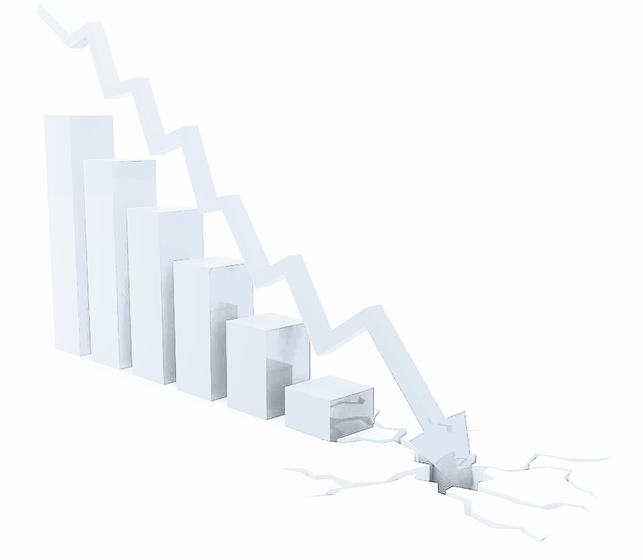
PRESENTATION ON EFFECT OF AUTOMATION AND ARTIFICIAL INTELLIGENCE (AI) ON ECONOMY GROWTH
COHORT 2, GROUP 8
Megastars
SDG 8 : Economic Growth

Slide 2




INTRODUCTION TO THE TEAMS
Vivian Aiguedowan
ozigbo.vivian@gmail.com
Malinga Kazi
Nokazi.malinga@gmail.com
Ifeoma Cynthia Ekenna – Team Lead
cinnykee@outlook.com
Valentine Korir valentinekorir234@gmail.com
Promise Oladimeji
oladimejipromise@gmail.com
Azrrzah Abaniwonnda
olsaabanny@gmail.com

Slide 3
OVERVIEW
INTRODUCTION
DATA VISUALIZATION
RECOMMENDATION
RESEARCH QUESTIONS
CONCLUSION
METHODS

Slide 4
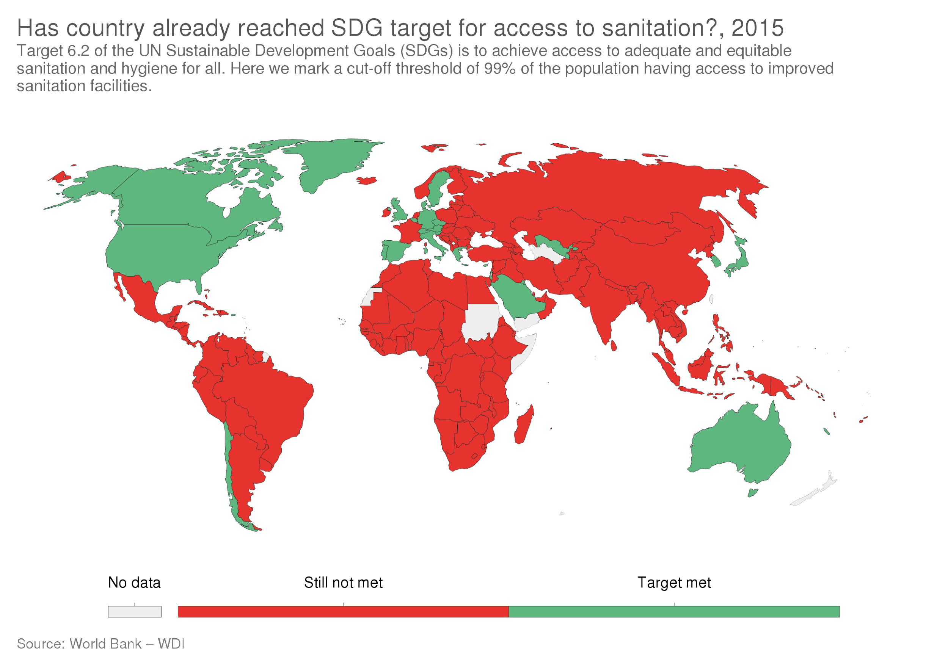
INTRODUCTION: SUSTAINED DEVELOPMENT GOAL 8
Promote sustained, inclusive and sustainable economic growth, full and productive employment and decent work for all

Slide 5

Sustain per capita economic growth in accordance with national circumstances and, in particular, at least 7 per cent gross domestic product growth per annum in the least developed countries
Achieve higher levels of economic productivity through diversification, technological upgrading and innovation, including through a focus on high-value added and labour-intensive sectors
Promote development-oriented policies that support productive activities.
By 2030, achieve full and productive employment and decent work for all women and men, including for young people and persons with disabilities, and equal pay for work of equal value
By 2020, substantially reduce the proportion of youth not in employment, education or training

Slide 6
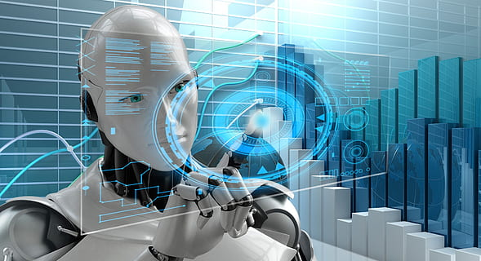
INTRODUCTION CONTD.
By 2030, AI has the potential to add 16% — or about $13 trillion — to the global economy. It could also boost the global gross domestic product (GDP) by up to 26% (Szczepański 2019)
The main contributor to the economic gains between 2017 and 2030 will come from consumer product enhancements stimulating consumer demand (8.4%). This is because AI will drive a greater choice of products, with increased personalisation and make those products more affordable over time.
Artificial intelligence(AI) is a constellation of technologies that enable machines to act emulate human capabilities
Notes:
The McKinsey Global Institute recently analyzed economic data from the United Nations, the World Bank, and the World EcTonomic Forum and reported that he McKinsey Global Institute recently analyzed economic data from the United Nations, the World Bank, and the World EcTonomic Forum and reported that the main contributor to the UK's economic gains between 2017 and 2030 will come from consumer product enhancements stimulating consumer demand (8.4%). This is because AI will drive a greater choice of products, with increased personalisation and make those products more affordable over time
The changing nature of work, including sectoral, industrial, and occupational composition, diversity of working arrangements, skill requirements and geography e.g. Africa, are multifaceted phenomena that manifest differently in around the world.
Globalization, or the development of an integrated global economy, forms an important driver using digital devices and software of the changes in the nature of work as well as our daily life.
Like the great technological breakthroughs over the last century — electricity, railways, and information technology — AI will boost productivity dramatically, maximizing output while fueling new economic growth.

Slide 7

RESEARCH QUESTIONS
How has AI influenced economic growth?
What is AI’s skill penetration trend over the years
Which industry does A.I penetrate the most?
Compare manufacturing and information; which influences economic growth better?

Slide 8







TOOLS & LIBRARIES USED

Slide 9
IMPACT OF AI PENETRATION ON A COUNTRY’S ECONOMIC GROWTH
Low income
Lower middle income
FIGURE 1
Upper middle income
Notes:
Give examples of countries grouped in the high/low income
What influences economic growth- polices, AI infrastructure, invest in AI education, absorb AI into systems
Manpower to keep up with upcoming processes that arise from AI

Slide 10
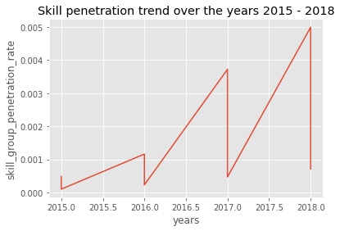
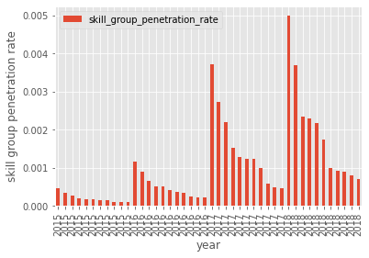
HOW HAS AI PENETRATION IN ALL THE INDUSTRIES GROWN OVER THE YEARS?
FIGURE 2
Notes:
11 industries AI has penetrated, trend over the years is continuous increase,
Unable to divide the data into whole years due to interim knowledge in python, explain to audience. Cinnie to insert a better graph of straight line

Slide 11
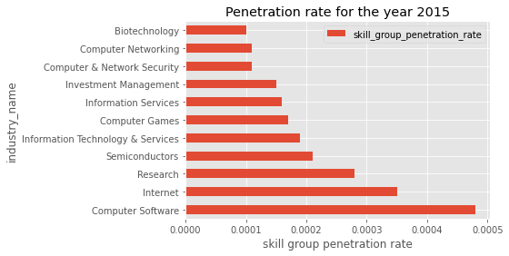
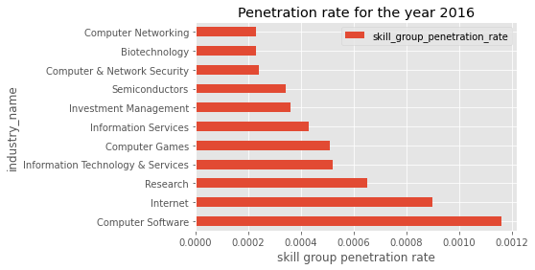


AI SKILL PENETRATION TREND FOR THE DIFFERENT YEARS
FIGURE 3
Notes:
Note: differences in the least penetrated

Slide 12
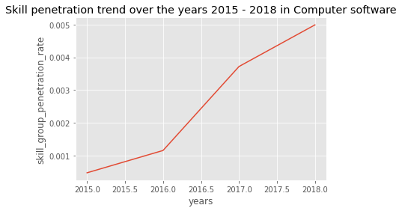
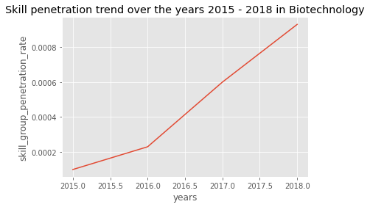
AI SKILL PENETRATION IN BIO TECH (LOWEST PENETRATED) VERSUS COMPUTER SOFTWARE (HIGHEST PENETRATED)
FIGURE 4
Notes:
The difference in rates of penetration, Bio Tech is lowest penetrated because it is involved in lab tests,
Penetration increases for both industries
Compare business skills vs AI, which is doing better

Slide 13
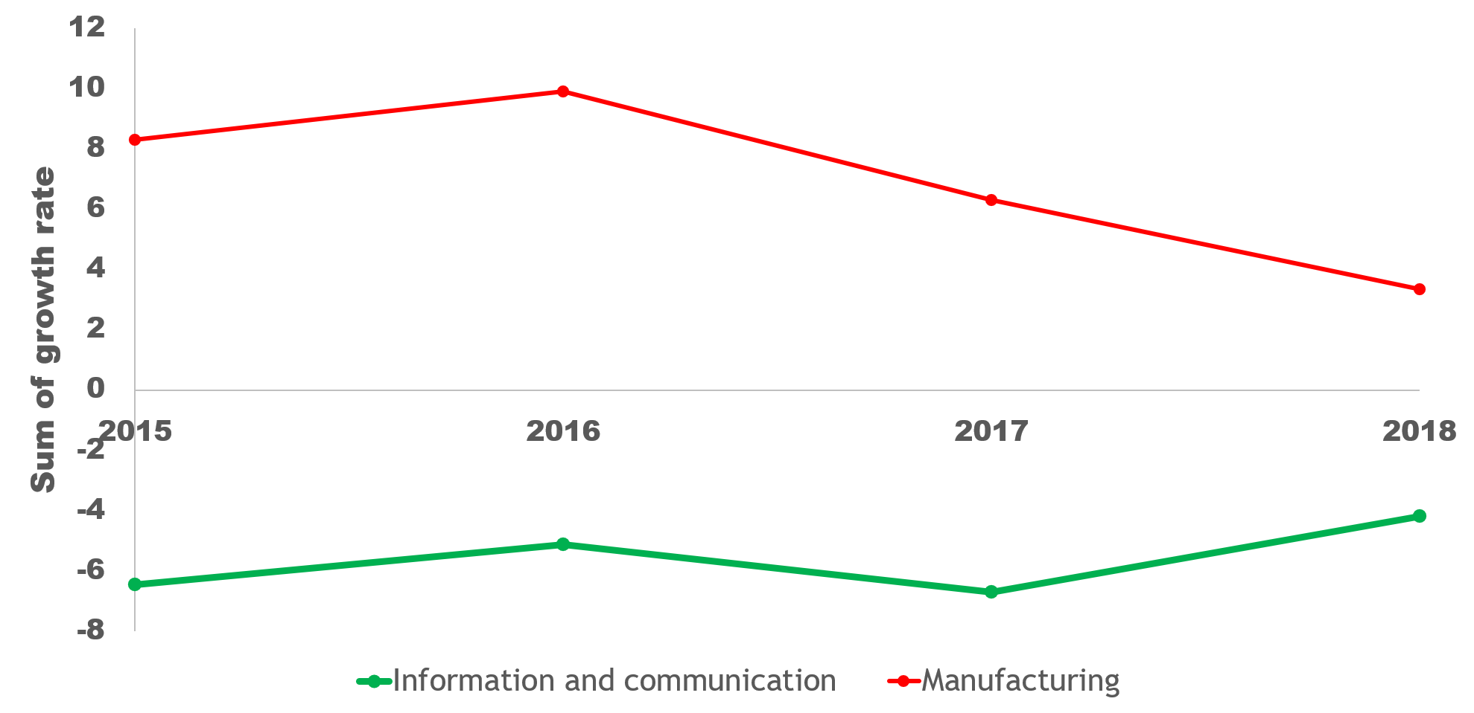
THE GROWTH BETWEEN INFORMATION AND COMMUNICATION AND MANUFACTURING
FIGURE 5
Notes:
Growth rate of Information and Tech versus communication versus. Manufacturing is nose diving while Info is coming up
According to the source of the data, LinkedIn industry growth data are calculated by LinkedIn panel data between 2014 and 2017. We capture new industry hires and losses by counting active LinkedIn members (who have logged in at least once in the past year) who move from one industry to another (experienced hires)

Slide 14
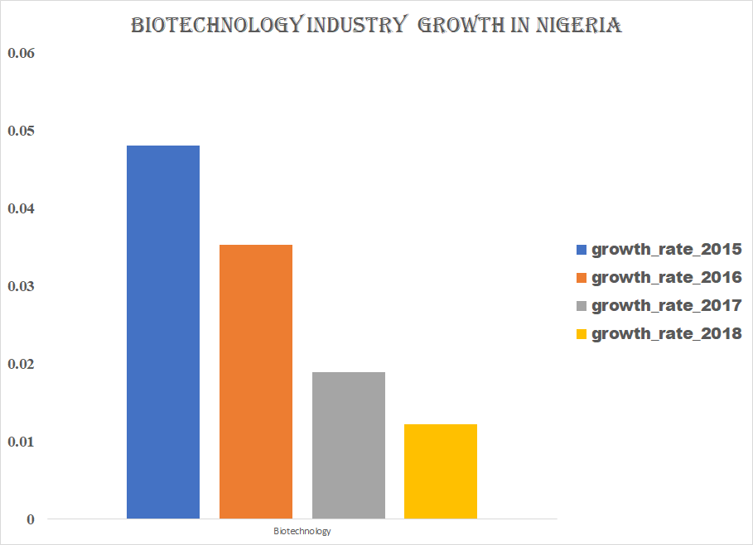
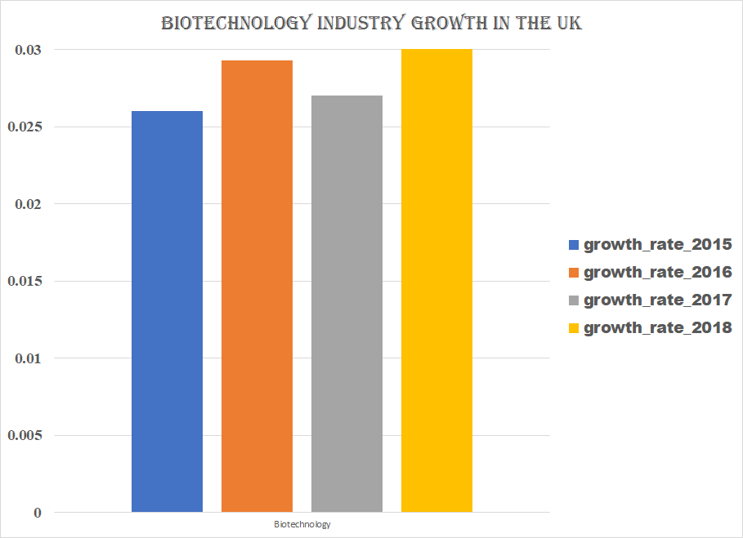
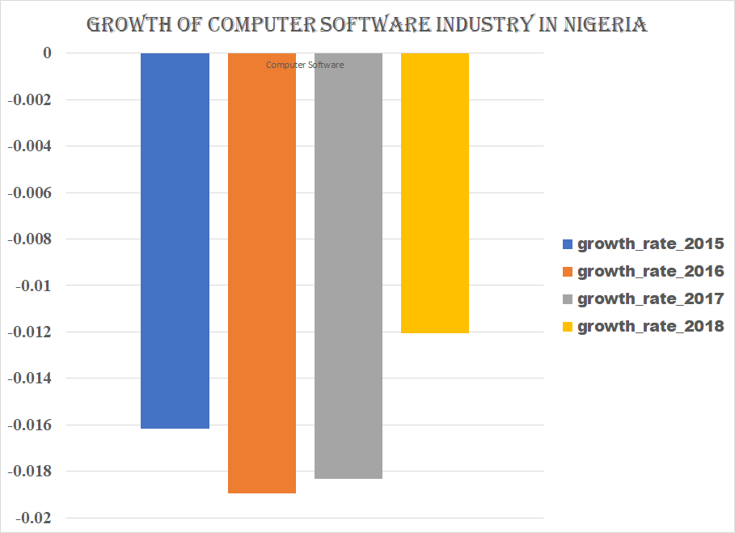
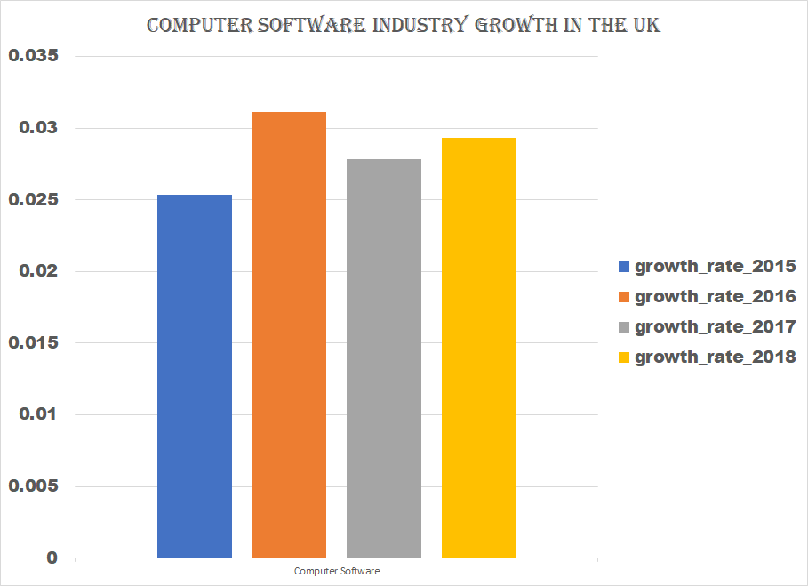
FIGURE 6
Notes:
Observe that the computer software industry is lagging in Nigeria compared to elsewhere in the world

Slide 15
FINDINGS
A.I has significantly influenced the economic growth over the years (figure 1).
A.I skill has grown in all industries over the years (figure 2).
Computer software industry is the most AI penetrated industry over the years and biotechnology is one of the least (figure 3).
Comparing Nigeria (lower middle income country) with the UK (high income country) shows a higher growth in AI penetration of industries in the UK which may be the cause for the higher income of UK
Notes:
A.I has significantly influenced the economic growth over the years as high income countries are using it a lot (figure 1)
A.I skill has grown in all industries over the years (figure 2)
Computer software industry is the most AI pentrated industry over the years and biotechnology is one of the least (figure 3).
Manufacturing has been one of the leading industry section but over the years it is decreasing while information and communication under which Computer software is domiciled is increasing in growth (figure 5).
Comparing Nigeria (lower middle income country) with the UK (high income country) shows a higher growth in AI pentetration of industries in the UK which may be the cause for the higher income of UK

Slide 16

CONCLUSIONS
High income countries have integrated AI in their systems better.
Government should encourage advance in disruptive skills such as AI in order to affect the maximum output and growth of the economy.

Slide 17

RECOMMENDATIONS (TO GOVT)
Invest in disruptive AI skills training.
Introduce policies that promote AI.
Support AI centric investments from abroad.
Diversify industries to avoid job losses.
Notes:
Disruptive skills training should be organized for the workforce as artificial intelligence is the way forward in our world today.

Slide 18


